Slide 1
What actions you need to take by 31st May 2010
ACTIONS
1. 2009/10 Performance Review Cycle 25th April 2010
Complete Self Review/Manager Review/One to One Review Steps
Send to your manager for signature/complete the 2009/10 Performance
review cycle
2. 2010/11 Performance Review Cycle 31st May 2010
Create your specific Performance and Development objectives for the year
Send to your Manager via workflow to gain agreement
If you need further help please discuss with your local HR team or Julie Hulme, Group HR Director.

Slide 2






Workflow and Performance Review Process 2010/11
A Performance Management Form is automatically routed to your inbox indicating what action is required. Below is the route map indicating the electronic actions. Current step will be highlighted in green
Planning step – log into the system and access your Objectives plan, define objectives for the review period that you consider most appropriate for your job role. Objectives created are automatically uploaded to your Scapa 2010 Performance Review Form. Once created you will trigger the workflow by sending them to your manager for review and agreement. In addition, you will also create your development plan using information from your 360 feedback. Objectives can be reviewed/updated at any stage by you or your manager
Mid Year Review step – a mid year checkpoint between you and your manager to discuss progress, update priorities and identify areas for development for the rest of the year. Log into the system and access your Performance Review Form in the Performance Tab. Comment on your progress to date and provide specific examples, where possible. Save your work and send it to your Manager by clicking the send to… button at the top of the screen. The form is routed to your manager who updates the Performance Review Form with feedback. Your manager completes the mid year review and routes to year end which returns to your Performance inbox.
Year End Review step consists of 3 parts: Self Review, Mgr review & One to One review. Log into the system and access your Performance Review Form in the Performance Tab. Rate your performance and competencies and give examples where possible. Save your work and send the form to your Manager. The form is routed to your manager who reviews your input and enters performance comments, objective and competency ratings. You and your manager will then arrange to have a one to one review session. You will also review your Development Plan during this meeting and update your Plan, as appropriate. After this your manager clicks ’Send to Employee for signature’ button to acknowledge the review has been completed
Signature Step - to complete the review you will click the ‘signature’ button at the top of the screen to indicate that the year end review has been completed and that you acknowledge the feedback on the Performance Form; or you may click ‘Decline’ button and comments on your reasons and request additional discussion regarding the feedback on the form. Once you have signed the form, it will be routed to your manager for signature. The signature comments field is final and not an interative step between you and your manager
Completed – All Completed forms are stored in your completed box under unfiled. You should create and maintain folders to organise your completed. You and your manager will receive a copy of the form in their inbox for filing.

Slide 3
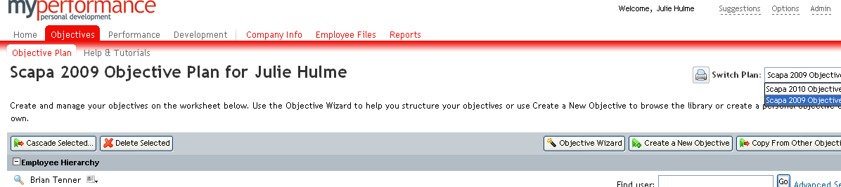
Selecting the Appropriate Performance Review Form
Click to select the appropriate Performance Review Form

